Slide 1
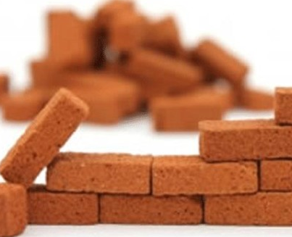
Protectionism
Building Barriers

Slide 2
Protectionism
Protectionism: The use of trade barriers to protect industries from foreign competition.
Types of trade barriers:
Tariffs
Import Quotas
Voluntary Export Restraint (VER)
Embargoes

Slide 3
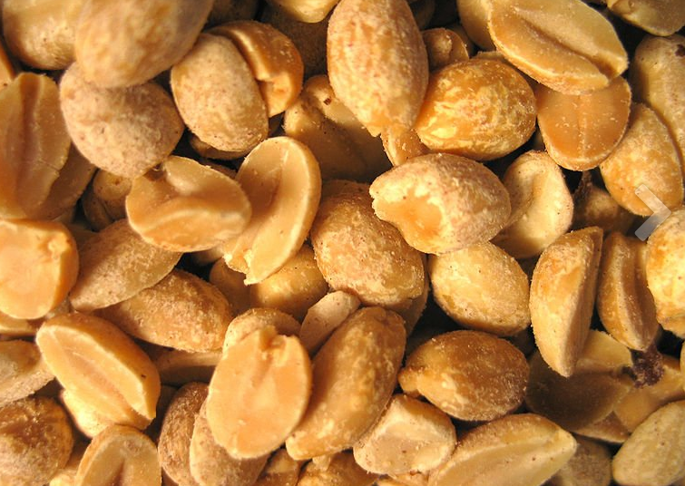
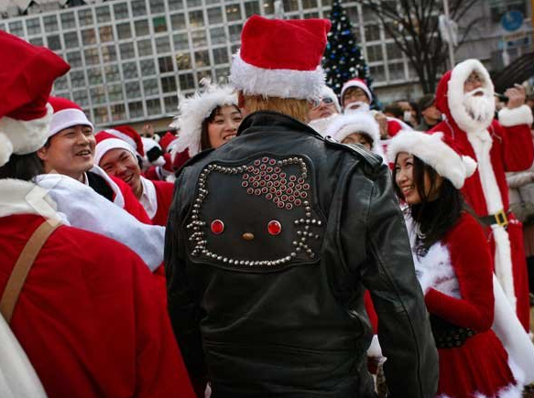
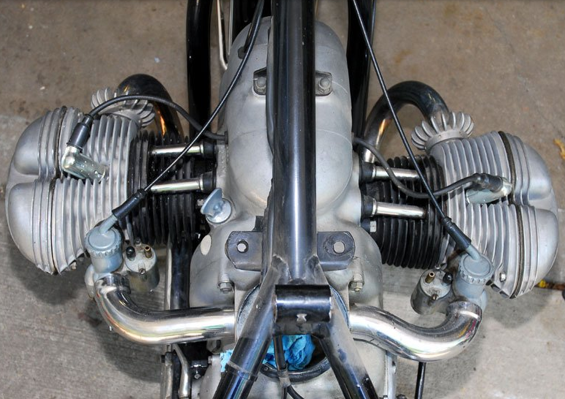
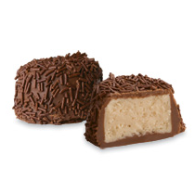
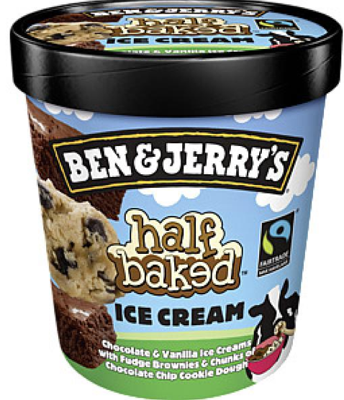
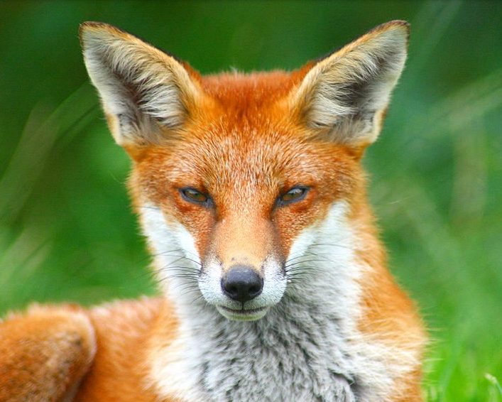
Tariff
Tariff: A list or system of duties imposed by a government on imported or exported goods.
Current Tariffs:
Dairy – 20%
Auto Parts – 25%
Japanese Leather – 40%
French Chocolate – 100%
Shelled Peanuts – 132%
Live Foxes – 5%

Slide 4
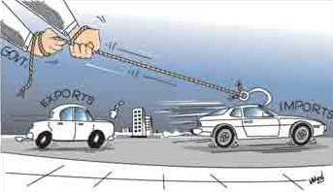
Import Quota
Import Quota: A limit on the amount of a good that can be imported.

Slide 5
Voluntary Export Restraint
Voluntary Export Restraint (VER): A self-imposed limitation on the number of products shipped to a particular country.
- Offered by the exporter to appease the importing country so they don’t imposing harsh trade barriers.

Slide 6
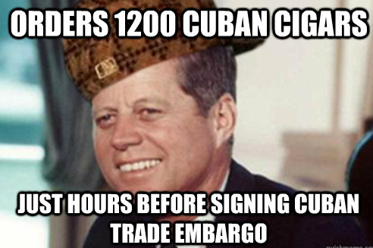
Embargo
Embargo: An official ban on trade or other commercial activity with a particular country.
Who do we shun?
North Korea – 1950
Iran – 1979
Syria – 1986
Sudan – 2002
Cuba – 1962

Slide 7
Trade Barriers = Trade Wars
Building Trade
Barriers is Bad!
This is why we build bridges…trade bridges

Slide 8
Why Protectionism?
It protects workers’ jobs.
It protects infant industries.
It protects national security.

Slide 9
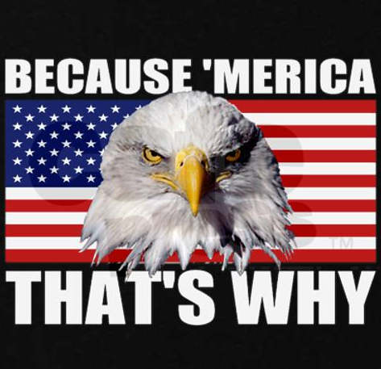
1. Protecting Workers’ Jobs
Shelters workers that would be hurt by foreign competition.
Lets look at the steel industry…
BUY AMERICAN!

Slide 10
BUT…
Negative:
Tariffs allows the government to receive revenue but can also cause economic challenges:
Price increase can be thought of as a reduction in consumer income.
Since consumers have less buying power they purchase less. Domestic producers in other industries in turn sell less which, causing a decline in the economy.
Therefore, tariffs take away purchasing power and decreases sales.
***Tariffs = Less Purchasing Power
Tariffs are bad for the overall economy!
Imagine if a cotton tariff was imposed on China…
Why???
Tariff
New ‘Merican Price
Domestic
Foreign

Slide 11
Stop, Collaborate, and Listen…
What if a foreign car company is selling its cars in the United States at a cheaper price than American car companies?
What barrier of trade could the U.S. impose?
What would the American car industries do in response?
How would Americans respond?
Is this good or bad for the economy? Why?
T.P.S

Slide 12
2. It Protects Infant Industries
Negatives:
It takes away incentives to become efficient and competitive.
Once given, the tariff is hard to take away because the infant never “grows up.”
Uses tariff to shield young company from foreign competition until it is more mature.
After able to produce goods efficiently at a competitive price the tariff is eliminated because they can compete.
BUT…

Slide 13
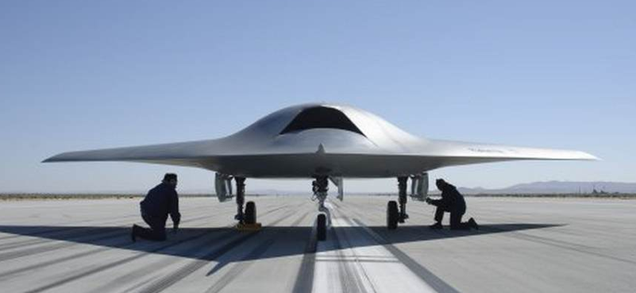
3. Protect National Security
- Some industries need tariffs because products are used to defend the country.
During war, countries need to be able to produce steel and other products, energy, and advanced technology.
Government wants to be sure these industries remain active in U.S.
Even free-trade supporters believe some industries need to be protected incase there is a crisis.

Slide 14
Trade Barriers are Bad!
Short story long…
Trade Barriers = Trade Wars

Slide 15
Barrier Bingo
Pair up…
First pair to get Bingo wins.
A Bingo can be made diagonally, horizontally, or vertically.

Slide 16
An acronym for Voluntary Export Restraint.

Slide 17
The U.S. imposes tax of 15% that makes jewelry from Mexico more expensive than jewelry made in the United States. This is an example of this type of trade barrier _________________.

Slide 18
The United States says Korea can export only 15,000 automobiles a year. This is an example of this type of trade barrier.

Slide 19
Even ____________________ supporters believe some industries need to be protected incase there is a national crisis.

Slide 20
In the video, how much of a pay cut did the steel workers get?

Slide 21
Tariffs on steel and advanced technology during times of war are used to …

Slide 22
We have this type of trade barrier with North Korea.

Slide 23
When the U.S. puts an embargo on a country it means we are…

Slide 24
A tariff is a…

Slide 25
A quota is a _____________________.

Slide 26
Protection of infant industries takes away __________________ to become more efficient and competitive.

Slide 27
When you use a tariff to shield a young company from foreign competition you are …

Slide 28
The United States imposed an embargo on Cuba in this year.

Slide 29
Tariffs, VERs, import quotas, and embargos are ___________________.

Slide 30
The tariff for a live fox is…

Slide 31
___________________ is the use of trade barriers to protect industries from foreign competition.

Slide 32
JFK ordered 1200 of these before he signed the Cuban Trade Embargo.

Slide 33
When Japan decides to limit the amount of foreign car exports to the U.S. this is an example of a __________________________ trade barrier.

Slide 34
My favorite class is ___________________.

Slide 35
There is a fear that infant industries may never ________________ under a tariff.

Slide 36
When we protect workers’ jobs we _______________ workers that would be hurt by foreign competition.

Slide 37
A Voluntary Export Restraint is a _________________________ on the number of products shipped to a particular country.

Slide 38
When you shelter workers who could be hurt by foreign competition you are…

Slide 39
Tariffs are ____________ for the overall economy.

