Slide 1
The High Cost of Low Prices

Slide 2
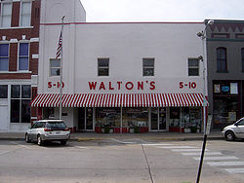
Wal-Mart 1948- 1 store. 1962- 2 (1969 incorporated). 1979- 276. 1985- 882 2005- 6,200= 312 billion in revenue. 2009- 408 Billion in revenue.

Slide 3
Wal-Mart Facts
Wal-Mart is the largest company in the world.
If Wal-Mart were a country, it would rank #21 in the world in terms of GDP.
Wal-Mart annual sales in 2005 were higher than Target, Sears, K-Mart, JC Penney and Kohl’s combined.

Slide 4
More Wal-Mart Facts
Wal-Mart is the largest private employer in the United States (1.7 million people).
Wal-Mart has 5,170 stores throughout the world.
*greater than GM, Ford, and IBM combined.
Wal-Mart sales in 06’ totaled $340 billion dollar.

Slide 5
Even More Wal-Mart Facts
Wal-Mart accounts for 10% of all Chinese exports.
If Wal-Mart were a country, it would be China’s seventh largest trading partner.

Slide 6
Is Wal-Mart Evil?
“Since the mid 1990s alone, cheap imports
from China have saved U.S. consumers
roughly $600 billion and saved U.S.
manufacturers untold billions in cheaper
parts and labor costs for their products.”

Slide 7
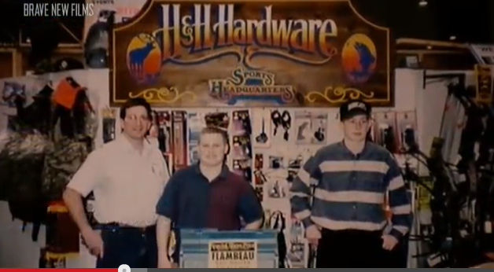
High Cost, Low Prices…
http://www.youtube.com/watch?v=pvhSnTwvw5Q

