Slide 1
Taxation with Representation

Slide 2
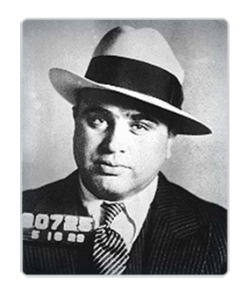
“The income tax law is a lot of bunk. The government can’t collect legal taxes from illegal money.”
- Al Capone

Slide 3
Taxes Fund Public Goods

Slide 4
Early Taxes
Cooking Oil, Foreigners, Slaves (Ancient Egypt)
Sales, Inheritance, Imports, Exports (Ancient Rome)
Beards Beehives, Boots, Souls (Russia, 1702)
Bachelors (England, 1695: Missouri, 1820)

Slide 5
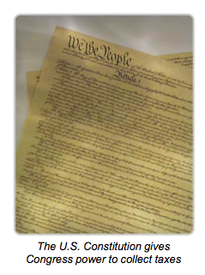
The Power to Collect Taxes
American Revolution cased debt.
Tax was necessary to pay debt.
Article 1, Section 8 of the U.S. Constitution granted Congress power to tax.

Slide 6
Three Tax Structures
Progressive – A larger % of income is taken in taxes as income increases.
Current income tax structure
Annual Salary Tax Rate
Ima Broke 9K. 15%
Jane Doe 100K. 25%
Sean Senn 400K. 33%
Seth Levi 4 M. 39.6%

Slide 7
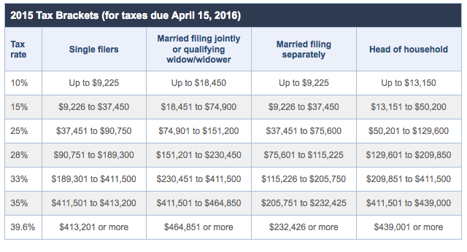

Slide 8
Three Tax Structures
2. Regressive Tax –
A smaller % of income is taken as income increases.
Sales Tax
Item taxed at flat rate regardless of income.
Example:
8 % sales tax on new $50,000 car = $4,000
Average U.S. Income – $50,500
Chris Hemsworth – $50,000,000

Slide 9
Three Tax Structures
3. Proportional - “Flat tax”
Same percent paid in taxes regardless of income level.
Annual Salary Tax Rate
Ms. Duke 250K. 28%
Honey Boo Boo 1 M. 28%
Robert Downey Jr. 5 M. 28%

Slide 10
Personal Opinion?
Which tax structure do you think is most equitable and why?
Proportional
Progressive

Slide 11
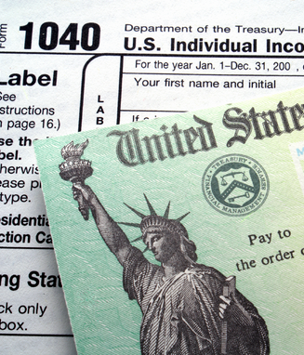
Four Tax Bases
Individual Income Tax -
16th Amendment (1913)
State
Federal
-FICA
Social Security
Medicare
(payroll tax= 12%)
6% employee
6% employer

Slide 12
Four Tax Bases
2. Sales Tax -
% tax on purchase of goods
Varies by county
In the Sales and Use Tax Law, the sale or use of certain tangible personal property is exempt from both sales and use tax. Examples include cold food products and prescription medicines.
Sin Tax -
Tax used to deter what is considered to be a legal but negative behavior.
Examples:
Alcohol
Cigarettes

Slide 13
Four Tax Bases
3. Property Tax -
% on each property owner
Paid annually
Varies by city

Slide 14
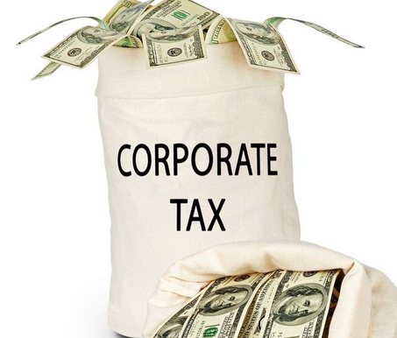
Four Tax Bases
4. Corporate Income Tax -
Corporations, like individuals, pay income tax on their earnings
State
Federal

Slide 15
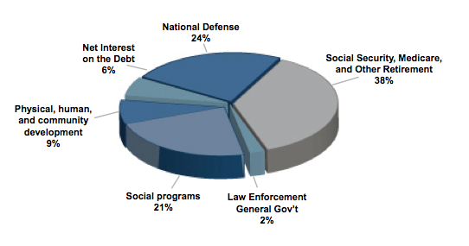
Where Does it Go?

Slide 16
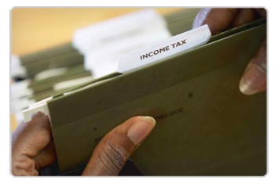
Ability to Pay Theory
Each person is responsible for filing a tax return.

Slide 17
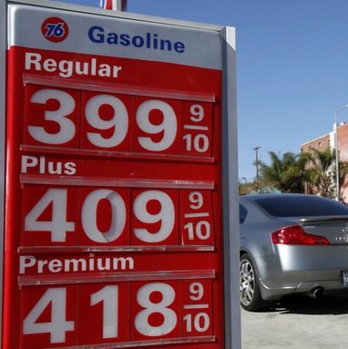
Benefits Received Theory
Those who directly benefit from the services provided by the taxation should pay the tax.
Example:
Gas tax = Revenue goes directly to roads and auto related issues.

Slide 18
Tax Evasion vs Tax Avoidance
Tax Evasion – Failure to pay legal taxes due.
Tax Avoidance – Legal means of decreasing your tax bill.
Exemptions: Fixed amount you can subtract.
Child tax credit
Charitable donation
Deductions: Variable amounts subtracted from income.
Mortgage interest
Tax sheltered investments

Slide 19
Other taxes……
Estate Tax - Placed on estates over $3,500,000 (45%)
2. Gift Tax - can give $13,000 per year tax free.
3. Import Tariff
4. Excise Tax - Tax on certain products and activities.

Slide 20
Citizens of Yelsel
You are a citizen of the country Yelsel and must come up with a tax structure. Your goal is to raise $2,000,000 - $5,000,000 through taxation. Then you must allocate the money to the programs listed on the handout. I will place you in groups based on your income, once in your groups you must…
Examine Yeslel’s population
Create a tax structure that makes sense and seems fair.
Agree on how to spend the money.
Answer the questions.
Create a chart that shows your tax system and indicate where the money is going to be used.
As a class, we will vote on the best tax structure.
**Winning group gets 5 extra credit points!

