Slide 1
So Many Goods - So Many Places
Absolute and Comparative Advantage

Slide 2
Buy American
Where was I made?
United States
Honduras
Thailand
Haiti
China
Bangladesh
Taiwan
Brazil

Slide 3
Why should people in the United States buy American made products?
At least three sentences.
Why Buy?

Slide 4
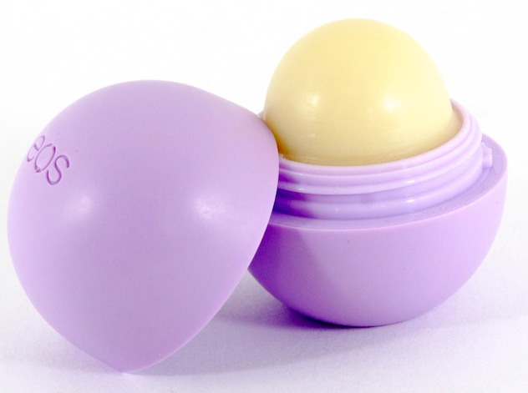
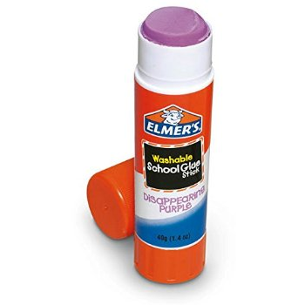
Guess Where Revealed…

Slide 5
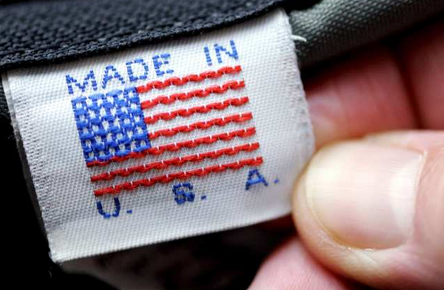
Debrief
Why do so many of you purchase foreign made goods? What was your incentive for buying from foreign producers?
If you are using American-made products, what was your incentive for purchasing them?
3. Did your purchase of foreign- made goods make our country better or worse off?

Slide 6
Absolute Advantage
Absolute Advantage:
The ability to produce more of a given product using a given amount of resources.

Slide 7
Comparative Advantage
Comparative Advantage:
The ability to produce a product most efficiently given all the other products that can be produced.

Slide 8
Lets meet……..

Slide 9
The Challenge…
Thalia and Chase attend Tesoro High School and are in the same economics class. Tonight’s economic assignment contains 2 math problems and 2 English problems. This assignment gives students the option of working in a group or individually. Tesoro High’s state championship volleyball game is tonight and both Chase and Thalia need to finish their homework prior to attending the game. Should Thalia and Chase work separately or together?

Slide 10
Absolute Advantage
Thali
Ch
English
10 Min.
40 Min.
Who takes the least amount of time to do their work ?
Math
20 Min.
30 Min.
Time
30 Min.
70 Min.

Slide 11
Thalia has an absolute advantage in English and math.

Slide 12
Remember opportunity cost?

Slide 13
Comparative Advantage
When Chase does the English, what does he give up?
 | Thalia | Chase
English | 10 min. | 40 min.
Math | 20 min. | 30 min.
When Thalia decides to do the math, how many English problems is she giving up?
Thalia has the comparative advantage in math.
Chase has the comparative advantage in English.
Opportunity Cost of Doing a Job
English
math
½ math
1 1/3 math
2 English
¾ English

Slide 14
Comparative Advantage
 | Thalia | Chase
English | 10 min. | 40 min.
Math | 20 min. | 30 min.
 | 30 min. | 70 min.
AFTER SPECIALIZING IN ONE JOB!
Chase = completes (2)math problems in 60 min. and saves 10 min.
Thalia = completes (2) English problems in 20 min. and saves 10 min.
*Specialization allows Thalia and Chase more time to engage in more productive behavior!

Slide 15
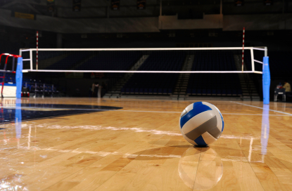

Slide 16
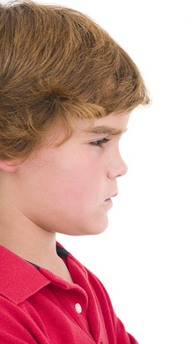
Now We Do…
Auva and Drew must clean their house.
They must complete 2 loads of dishes and take out 2 loads of trash.
Auva can wash 1 load of dishes in 20 minutes
And she can take out 1 load of trash in 30 minutes.
Drew can wash 1 load of dishes in 50 minutes.
And he can take out 1 load of trash in 40 minutes.
Who has the absolute advantage?
Who has the comparative advantage?

Slide 17
Absolute Advantage
Dishes
20 min.
50 min.
Who takes the least amount of time to do their work ?
Trash
40 min.
30 min.
Time
50 min.
90 min.

Slide 18
Auva has an absolute advantage in doing the dishes and taking out the trash.

Slide 19
Drew is incompetent compared to his rock star sister.

Slide 20
Comparative Advantage
 | Auva | Drew
Dishes | 20 min. | 50 min.
Trash | 30 min. | 40 min.
When Auva takes out the trash, how many loads of dishes does she give up?
When Drew does the dishes, what dose he give up?
Auva has the comparative advantage in doing the dishes.
Drew has the comparative advantage in taking out the trash.
Opportunity Cost of Doing a Job
Dishes
Trash
2/3 Trash
1 ¼ Trash
1 1/3 Dish
4/5 Dish

Slide 21
Comparative Advantage
 | Auva | Drew
Dishes | 20 min. | 50 min.
Trash | 30 min. | 40 min.
 | 50 min. | 90 min.
AFTER SPECIALIZING IN ONE JOB!
Auva saves 10 minutes.
Drew saves 10 minutes!

