Slide 1
Banking and You

Slide 2
Why do you put your money in a bank?
Store money.
Safe.
Convenient.
Pays interest.
FDIC insured.

Slide 4
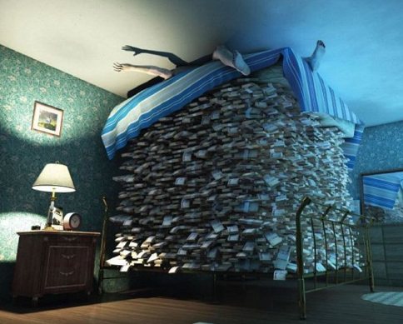
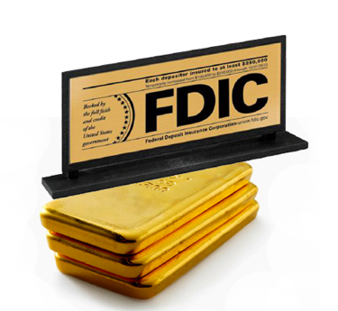
What is FDIC?
FDIC – Federal Deposit Insurance Corporation
- Created in 1933.
- Insures individual deposits up to $250,000.
NOT FDIC INSURED!

Slide 5
What do banks do?
Banks and Financial Institutions are essential for managing the money supply.
-They save and store our money.
-They loan money to businesses, and individuals.
-They are also businesses/profit seeking firms.

Slide 6
Save Money
You can chose to save your money different ways:
Savings Account
Checking Account
Money Marketing Account
Certificate of Deposit (CD)

Slide 7
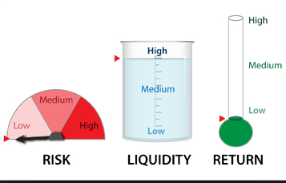
Saving and Checking Accounts
- These are the most common forms of savings.
- People withdraw from them most frequently.
- They accrue less interest than money markets or CDs.

Slide 8
Money Markets and CDs
Certificate of Deposit (CDs)
- A guaranteed rate of interest
-Must remain in the account for
a specified amount of time
-Cannot be removed without penalty
- Special kinds of saving accounts.
- They pay higher interest rates.
Money Markets
- Interest rates can vary
(go up or down)
- Allows you to save
- You are able to write a limited number of checks

Slide 9
How to make money while you save money:
Save money- Pay % interest to depositor.
-simple interest = Interest paid only on principal.
-compound interest = Interest paid on both principal and accumulated interest.

Slide 10
Simple VS Compound Interest
Simple interest does NOT make you as much money as compound…
You want compounded interest…
And here’s why…
Invested at 5% Interest | Simple | Compound | Difference
Start | 5,000 | 5,000 | 0
After Year 1 | 5,250 | 5,250 | 0
After Year 2 | 5,500 | 5,512.50 | 12.50
After Year 3 | 5,750 | 5,788.13 | 38.13
After Year 4 | 6,000 | 6,077.53 | 77.53
After Year 5 | 6,250 | 6,381.41 | 131.41

Slide 11
Compound Interest: Rule of 72
Rule of 72:
The rule says that to find the number of years required to double your money at a given interest rate, you just divide the interest rate into 72.
Example:
How long will it take to double your money at 8% interest?
Divide 8 into 72 = 9 years

Slide 12
Fractional Banking
Most banks practice Fractional Reserve Banking.
Fractional Reserve Banking: The banks keep a fraction of your deposit and loans out the rest.
Ex. Businesses seek loans to grow, this money comes from other people’s deposits.

Slide 13
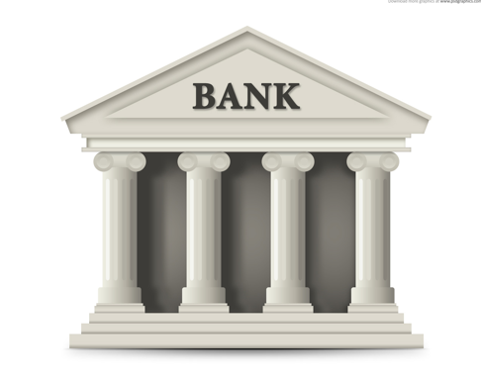
Fractional Reserve Banking
Deposit
“Money In”
$100.00
Loan
“Money Out”
$70.00
Banks keep 30% of your deposit in reserves and invest the rest to make $

Slide 14
Other Ways Banks Make Money
Fees: ATM, Checking, Savings, Credit Cards
- Interest charged to borrowers = They charge you interest for borrowing “their” money. Loans are the largest source of income for banks.
*Banks are business/profit seeking firms
so loans are used to make them money!

