Slide 1
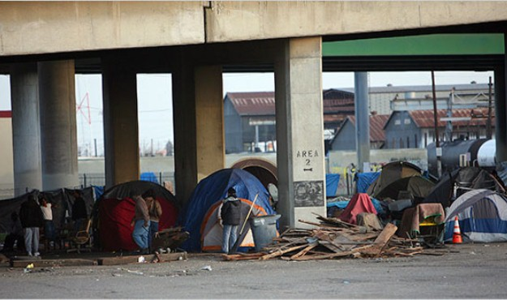
Poverty in America

Slide 2
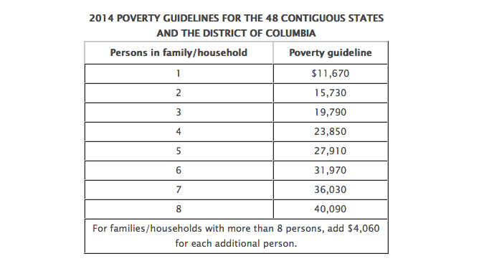
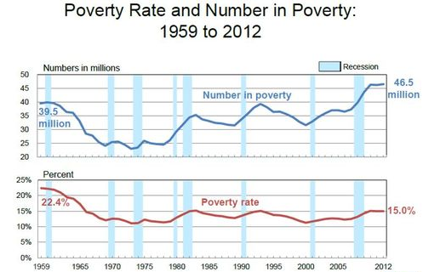
Poverty threshold- the income level below which income is insufficient to support a family or household.
Poverty rate- the percentage of people who live in households with income below the official poverty line

Slide 3
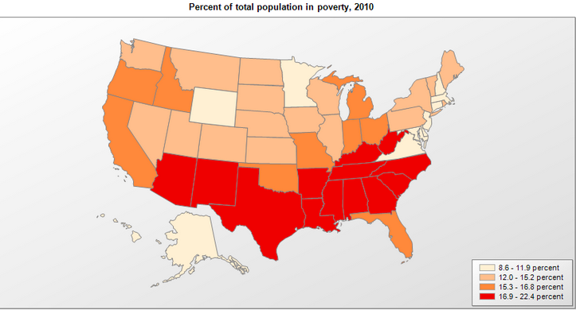

Slide 4
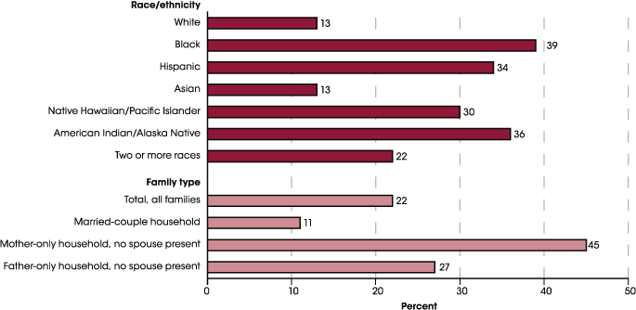

Slide 5
$7.25
_______________ is the current Federal minimum wage.
1. How much does a person working 40 hours a week on minimum wage earn per month?
40 x ______ = _________ gross weekly income x 4 =
_________ gross monthly income.
Subtract - 15% (tax) _____________= ___________ net monthly income.
Annual salary = _______________ ($11,670.00 is the 2014 poverty threshold).
$7.25
$290.00
$1,160
-$174.00
$986.00
$11,832.00

Slide 6
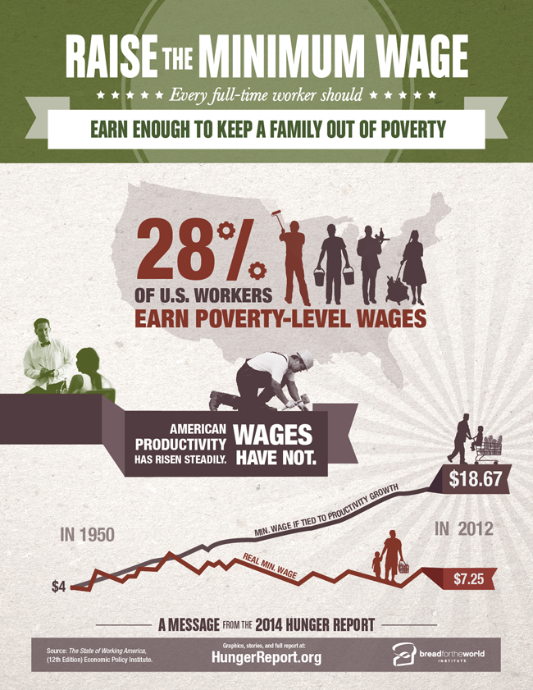
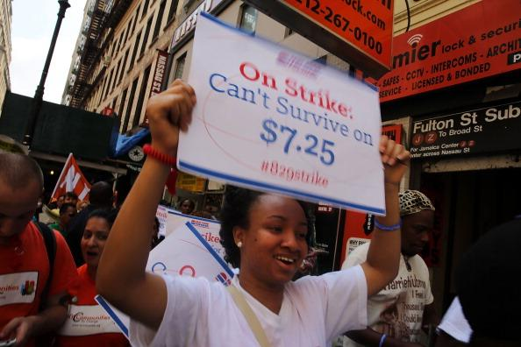
The Working Poor

Slide 7
30 Days Minimum Wage
America’s Working Poor

Slide 8
Minimum Wage Rates By State
http://www.dol.gov/whd/minwage/america.htm

Slide 9
Debriefing Questions
Should we raise minimum wage?
How could raising the minimum wage affect large and small companies?
How could raising minimum wage affect individuals?
Is there a solution?

